Slide 1
A Seminar on ENHANCED MEDICAL DATA SECURITY FRAMEWORK
Team Details
B.Mounika(20EG105404)
K.Surya Teja(20EG105418)
P.Manvitha(20EG105434)
Project Supervisor
Dr.K.Madhuri
Associate professor

Slide 2
INTRODUCTION
Data is the information that can be collected, analyzed,and used for various purposes. There is an underlying need to understand the functionalities that the data is processed through. Most of the data we know about is confidential and important, like medical data. Medical data can refer to patient’s health records, medical history, diagnosis, prescriptions and much more. This type of data cannot be public. The data must be accessible only between patient and respective doctor. Handful of strategies can be applied to medical data. Data storage, data security, data sharing. as sub applications this data can also be encrypted and then decrypted, even access control policy can be applied.

Slide 3
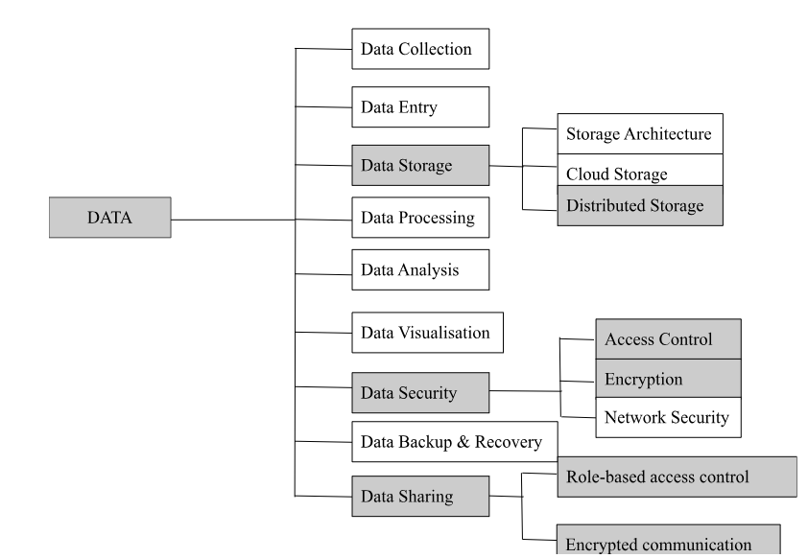
CONCEPT TREE

Slide 4
LITERATURE Selected Strategy:
Method | Advantages | Disadvantages
Data Storage: Distributed Storage | Provides improved performance Scalable Flexible Data Sharing is easy Cost-effective | Lack of centralized control Security Risks
Data security: Access Control | Confidentiality Protection against unauthorized access Data Integrity User accountability | Complex Risk of misconfiguration
Data Security: Encryption | Confidentiality Data integrity Authentication | Key management Usability Decryption risks
Data Sharing: Role-based access control | Granular Access Control Simplified administration Scalable Enhanced security | Complex Risk of overprivilege Static nature
Data Sharing: Encrypted communication | Secure Private Global communication | Key Management Usability Challenges
Department of Computer Science and Engineering
4

Slide 5
LITERATURE
Author(s) | Strategies | Advantages | Disadvantages
Ovunc Kocabas, Tolga Soyata Mehmet K. Aktas | Data acquisition Data aggregation Cloud processing | data sharing based on the credentials of the sharing parties. computation on encrypted data is feasible | Potential Security Risks Performance impact Hardware and communication constraints
Prosanta Gope Youcef Gheraibia Sohagd Biplab Sikdar Kabir | Introducing a Physical Unclonable Function (PUF)-based authentication scheme and a data-driven fault-tolerant decision-making scheme for designing an IoT-based modern healthcare system | Robust decision making Efficient | Complex High maintenance and frequent updation. Need for training professionals
Daojing He, Sammy Chan Shaohua Tang | Hash-chain-based key updating mechanism and proxy-protected signature technique for MSNs | Feasible for real-world applications. Suitable for the low-power sensor nodes Achieve efficient transmission and fine-grained data access control. | Compatibility and integration Resource utilization Key management
Department of Computer Science and Engineering

Slide 6
Author(s) | Strategies | Advantages | Disadvantages
Han Qiu Meikang Qiu Meiqin Liu Gerard Memmi | A selective encryption algorithm combined with fragmentation and dispersion | Protects the data on a trusted device Let the end-user control the Access for data sharing It can avoid data leakage even when the keys are compromised. | Backup and recovery User education Long term viability Complex
Department of Computer Science and Engineering

Slide 7
PROBLEM STATEMENT
Much sensitive data is associated with medicine that cannot be publicly displayed. Existing methods have not provided the encryption with text files, access control policy was not introduced,and an interface for patient and doctor to communicate is not provided. In the current need to secure medical data that should only be accessed by authorized individuals or an organization, this approach concentrates on establishing data security and communication.

Slide 8

PROBLEM ILLUSTRATION
The system is associated with providing security to image and audio files from implantable devices in the human body via the internet. Algorithms like RC6, ECDSA, and SHA-256 are combined as a hybrid algorithm. RC6 algorithm is used for generating a key value, and EDCSA encrypts the first generated key value then the encrypted key value is sent to a secure hash algorithm.

Slide 9
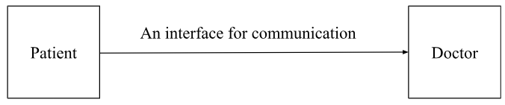
The whole process of using three algorithms for encryption and decryption is complex and time-consuming. So, we can find a better algorithm to replace them.
The major limitation of the provided system is there is no interface or framework to connect the sender and receiver of the files. An interface will be established as an improvement.
Department of Computer Science and Engineering

Slide 10
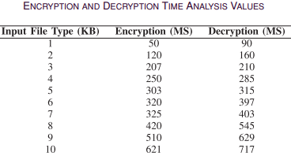
The time analysis is provided for encryption and decryption when the RC6 algorithm is used.
The chosen algorithm must take less time to encrypt and decrypt.
Department of Computer Science and Engineering

Slide 11
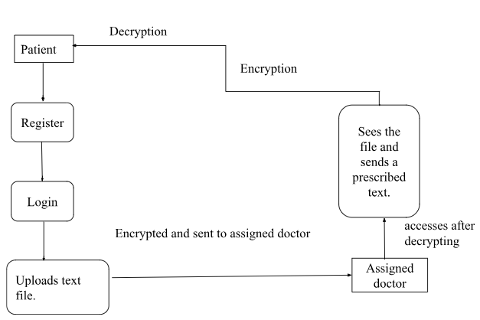
PROPOSED METHOD
Attribute-based encryption technique is proposed where patient data is encrypted as a text file using the AES encryption technique and access permission is given to the respective doctor to restrict access to other users. Users can view encrypted patient data and send requests to the owner to get a security key to download patient data and view data. If the access control policy is not satisfied user can't get the security key to download.
Department of Computer Science and Engineering

Slide 12
PROPOSED METHOD ILLUSTRATION
File upload: F1
(Encryption Time: T1)
Encrypt: E1 Attribute-based encryption: ABE1 Submit-Store
Request: R1
Verify
(Decryption Time: T2)
Respond: RE1 Download Key: K1 Decrypt: D1

Slide 13
PARAMETERS
Encryption Time :
The encryption time for a typical 256-bit AES implementation is generally very fast, often measured in microseconds or milliseconds for small to moderate-sized data.
Larger files may require more time, and factors such as parallelization and hardware acceleration can significantly impact encryption speed.
Decryption time :
Decryption time for AES with a 256-bit key size is typically similar to the encryption time, as the encryption and decryption processes involve similar steps.
AES decryption is a reversible process, and the computational cost is similar to that of encryption.

Slide 14
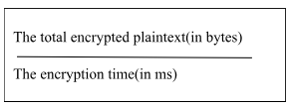
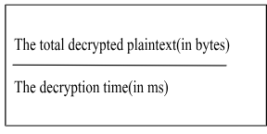
Access control:
Access is granted or denied based on the user's identity and the access control policies.
Formula: Access(U, O) = Permit/Deny
U: User identity.
O: Encrypted data or decryption key.
Time analysis:
The throughput of any process of encryption is calculated as:
The throughput of any process of decryption is calculated as :
Department of Computer Science and Engineering

Slide 15
EXPERIMENT ENVIRONMENT
Coding Language: Java Programming language
Front End: HTML,CSS
IDE: NetBeans
Database: My SQL

Slide 16
PROJECT STATUS
S.No | Functionality | Status (Completed /in-progress/Not started)
1 | Interface | In-Progress
2 | Encryption | In-progress
3 | Access Control Policy | Not started
4 | Key requests | Not started.
5 | Decryption | Not started
6 | Time Analysis | Not started

Slide 17
REFERENCES
[1] O. Kocabas, T. Soyata, and M. K. Aktas, “Emerging security mechanisms for medical cyber-physical systems,” IEEE/ACM Trans. Comput. Biol. Bioinf., vol. 13, no. 3, pp. 401–416, May/Jun. 2016
[2] P. Gope, Y. Gheraibia, S. Kabir, and B. Sikdar, “A secure IoT-based modern healthcare system with fault-tolerant decision-making process,” IEEE J. Biomed. Health Informat., vol. 25, no. 3, pp. 862–873, Mar. 2021.
[3] D. He, S. Chan, and S. Tang, “A novel and lightweight system to secure wireless medical sensor networks,” IEEE J. Biomed. Health Informat., vol. 18, no. 1, pp. 316–326, Jan. 2014.
[4] H. Qiu, M. Qiu, M. Liu, and G. Memmi, “Secure health data sharing for medical cyber-physical systems for the healthcare 4.0,” IEEE J. Biomed. Health Informat., vol. 24, no. 9, pp. 2499–2505, Sep. 2020

Slide 18
THANK YOU

Slide 19
PROJECT SEMINAR–I EVALUATION
S.No | Rubrics | Marks
1 | Concept Introduction | 4
2 | Literature and Parameter | 5
3 | Problem and Problem Illustration | 8
4 | Proposed Method and Illustration | 8
Total |  | 25

